Slide 1

Built-in Physical and Logical Replication in Postgresql

Slide 2

Fırat Güleç
- Company
Hepsiexpress
- Now
Infrastructure & Database Manager
PostgreSQL Consulting
Member of Postgresql Europe
Contributing to Open Source Community

Slide 3
Agenda
What is Replication?
Why do we need Replication?
How many replication layers do we have?
Understanding milestones of built-in Database Physical Replication.
What is the purpose of replication? and How to rescue system in case of failover?
What is Streaming Replication and what is its advantages? Async vs Sync, Hot standby etc.
How to configurate Master and Standby Servers? And What is the most important parameters? Example of topoloji.
What is Cascading Replication and how to configurate it? Live Demo on Terminal.
Quorum Commit for Sync Replication etc.
What is Logical Replication coming with PostgreSQL 10? And What is its advantages?
What is the purpose of Logical replication?
How to set up Logical Replication and What are its benefits?
Limitations of Logical Replication
Logical Replication vs Physical Replication in detail.
10 Questions quiz and giving some gifts to participants according to their success.

Slide 4


What is Replication?
Slave
Slave
Slave
Slave
Slave
Master
Slave
Slave
Slave
Slave
Notes:
Servers that can modify data are called read/write, master or primary servers. Servers that track changes in the master are called standby or slave servers. A standby server that cannot be connected to until it is promoted to a master server is called a warm standby server, and one that can accept connections and serves read-only queries is called a hot standby server.
This can be used to reduce the number of direct connections to the master and also to minimize inter-site bandwidth overheads.

Slide 5
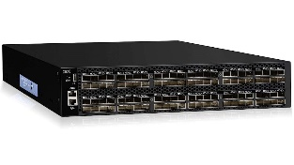

Replication Layers
Pgpool II
Londiste
Application
Database logical
Database physical
Operating System
Hardware
Bucardo
Slony
Logical Replication
Streaming Replication
DRBD
SAN
NAS

Slide 6
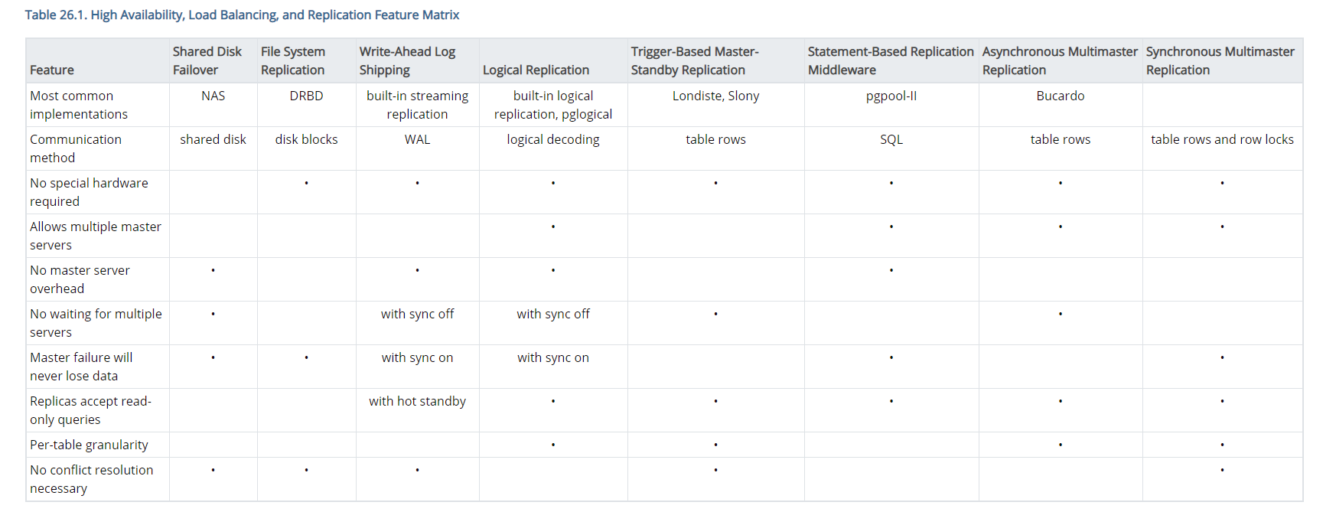
High Availability, Load Balancing, and Replication Feature Matrix
https://www.postgresql.org/docs/11/different-replication-solutions.html

Slide 7
Pyhsical Replication

Slide 8


The purpose of Streaming Replication?
Client
App Server
High availability
Master
Slave

Slide 9
The purpose of Streaming Replication?
Client
App Server
Load Balancing
%50
%50
Master
Slave

Slide 10
Database Physical Replication Milestones
Synchronous since 9.1
Quorum commit since 10.0
File based from 8
Streaming Replication 9.0

Slide 11
Architecture of Streaming Replication
WAL Record
WAL sender
WAL receiver
Master
Slave
WAL
Archieve directory
WAL
16 MB
pg_wal
Notes:
The amount of data loss is proportional to the replication delay at the time of failover.
When requesting synchronous replication, each commit of a write transaction will wait until confirmation is received that the commit has been written to the transaction log on disk of both the primary and standby server. The only possibility that data can be lost is if both the primary and the standby suffer crashes at the same time. This can provide a much higher level of durability, though only if the sysadmin is cautious about the placement and management of the two servers. Waiting for confirmation increases the user's confidence that the changes will not be lost in the event of server crashes but it also necessarily increases the response time for the requesting transaction. The minimum wait time is the roundtrip time between primary to standby.
Read only transactions and transaction rollbacks need not wait for replies from standby servers. Subtransaction commits do not wait for responses from standby servers, only top-level commits. Long running actions such as data loading or index building do not wait until the very final commit message. All two-phase commit actions require commit waits, including both prepare and commit.

Slide 12
Database Physical
Synchronous since 9.1
Quorum commit since 10.0
File based from 8
Streaming Replication 9.0

Slide 13
File based Replication from Postgresql 8.3
WAL Record
WAL sender
WAL receiver
Master
Slave
WAL
Archieve directory
WAL
WAL
16 MB
16 MB
pg_wal
Notes:
Streaming replication allows a standby server to stay more up-to-date than is possible with file-based log shipping. The standby connects to the primary, which streams WAL records to the standby as they're generated, without waiting for the WAL file to be filled.

Slide 14
Database Physical
Synchronous since 9.1
Quorum commit since 10.0
File based from 8
Streaming Replication 9.0

Slide 15
Streaming Replication
The primary and standby servers so that they are as similar as possible
Record-based log shipping
1- Major PostgreSQL release levels should be same
2- 32-bit to a 64-bit system will not work.
WAL Record
WAL sender
WAL receiver
Master
Slave
WAL
WAL
Archieve directory
WAL
16 MB
pg_wal
pg_wal
Notes:
The amount of data loss is proportional to the replication delay at the time of failover.
When requesting synchronous replication, each commit of a write transaction will wait until confirmation is received that the commit has been written to the transaction log on disk of both the primary and standby server. The only possibility that data can be lost is if both the primary and the standby suffer crashes at the same time. This can provide a much higher level of durability, though only if the sysadmin is cautious about the placement and management of the two servers. Waiting for confirmation increases the user's confidence that the changes will not be lost in the event of server crashes but it also necessarily increases the response time for the requesting transaction. The minimum wait time is the roundtrip time between primary to standby.
Read only transactions and transaction rollbacks need not wait for replies from standby servers. Subtransaction commits do not wait for responses from standby servers, only top-level commits. Long running actions such as data loading or index building do not wait until the very final commit message. All two-phase commit actions require commit waits, including both prepare and commit.

Slide 16
Database Physical
Synchronous since 9.1
Quorum commit since 10.0
File based from 8
Streaming Replication 9.0

Slide 17
Streaming Replication
1- Async vs Sync
2- Hot Standby or Warm Standby?
write
read
read
WAL Record
WAL sender
WAL receiver
Master
Slave
WAL
Archieve directory
WAL
16 MB
pg_wal
Notes:
Streaming replication is asynchronous by default (see Section 26.2.8), in which case there is a small delay between committing a transaction in the primary and the changes becoming visible in the standby. This delay is however much smaller than with file-based log shipping, typically under one second assuming the standby is powerful enough to keep up with the load. With streaming replication, archive_timeout is not required to reduce the data loss window.
The amount of data loss is proportional to the replication delay at the time of failover.
When requesting synchronous replication, each commit of a write transaction will wait until confirmation is received that the commit has been written to the transaction log on disk of both the primary and standby server. The only possibility that data can be lost is if both the primary and the standby suffer crashes at the same time. This can provide a much higher level of durability, though only if the sysadmin is cautious about the placement and management of the two servers. Waiting for confirmation increases the user's confidence that the changes will not be lost in the event of server crashes but it also necessarily increases the response time for the requesting transaction. The minimum wait time is the roundtrip time between primary to standby.
Read only transactions and transaction rollbacks need not wait for replies from standby servers. Subtransaction commits do not wait for responses from standby servers, only top-level commits. Long running actions such as data loading or index building do not wait until the very final commit message. All two-phase commit actions require commit waits, including both prepare and commit.

Slide 18
Database Physical
Synchronous since 9.1
Quorum commit since 10.0
File based from 8
Streaming Replication 9.0

Slide 19
Quorum Commit for Sync Replication
10.0: Quorum Commit
sync
Slave 1
sync
Master
Slave 2
10.0→synchronous_standby_names FIRST 2 (s1, s2, s3)
sync
10.0→synchronous_standby_names ANY 2 (s1, s2, s3)
Slave 3
Notes:
Traditionally, only one server could act as a synchronous standby. This has changed. In PostgreSQL 10.0, the community has introduced quorum COMMITs. The idea is actually quite simple. Suppose you want five out of seven servers to confirm a transaction before the master returns a COMMIT. This is exactly what a quorum COMMIT does. It gives the developers and administrators a chance to define what COMMIT does in a more fine-grained way.

Slide 20


6 Steps for Streaming Replication
3. Authentication
6. Create Recovery.conf
1. Replica user is created
5. Synchronization
Master
Slave
2. Configuration for Master
4. Configuration for Slave
Notes:
Create replication user in Master
Configuration for Master
configuration for authentication
Configuration for Slave
Syncronize Data from Master Server to Slave
Create recovery.conf file

Slide 21
Hot Standy - postgresql.conf
wal_level → determines how much information is written
wal_level=‘minimal’
wal_level=‘replica’
wal_level=‘logical’
Notes:
-minimal : only information needed to recover from a crash or an immediate shutdown
-replica : enough data to support WAL archiving and replication
-logical : enough information to support logical decoding.

Slide 22
max_wal_senders
max_wal_senders= specifies the maximum
number of concurrent connections
Slave
Master
Slave
Slave
Notes:
Specifies the maximum number of concurrent connections from standby servers or streaming base backup clients (i.e., the maximum number of simultaneously running WAL sender processes). The default is 10. The value 0 means replication is disabled. WAL sender processes count towards the total number of connections, so this parameter's value must be less than max_connections minus superuser_reserved_connections. Abrupt streaming client disconnection might leave an orphaned connection slot behind until a timeout is reached, so this parameter should be set slightly higher than the maximum number of expected clients so disconnected clients can immediately reconnect. This parameter can only be set at server start. Also, wal_level must be set to replica or higher to allow connections from standby servers.

Slide 23
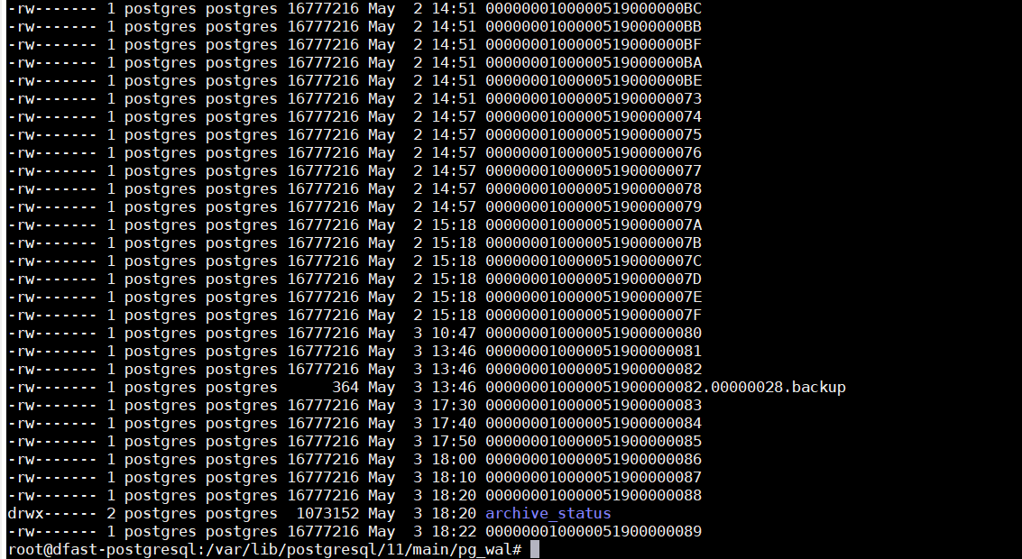
wal_keep_segments
Notes:
Specifies the minimum number of past log file segments kept in the pg_xlog directory, in case a standby server needs to fetch them for streaming replication.

Slide 24
wal_keep_segments
WAL Record
WAL sender
WAL receiver
Master
Slave
WAL
Archieve directory
WAL
WAL
16 MB
pg_wal
Notes:
Specifies the minimum number of past log file segments kept in the pg_wal directory, in case a standby server needs to fetch them for streaming replication. Each segment is normally 16 megabytes. If a standby server connected to the sending server falls behind by more than wal_keep_segments segments, the sending server might remove a WAL segment still needed by the standby, in which case the replication connection will be terminated. Downstream connections will also eventually fail as a result. (However, the standby server can recover by fetching the segment from archive, if WAL archiving is in use.)

Slide 25
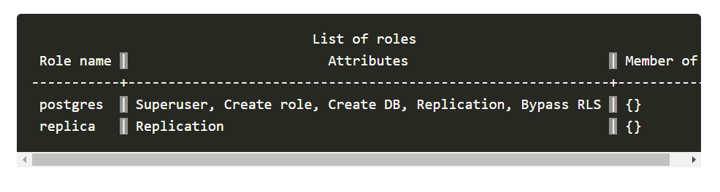
1-Replication User for Master
sudo -u postgres psql
Next, create a new user and role with the following command:
postgres=#CREATE USER replica REPLICATION LOGIN ENCRYPTED PASSWORD ‘*******';
postgres=#\du
You should see the following output:

Slide 26
2-Hot Standby Configuration for Master
in postgresql.conf
wal_level=replica
wal_keep_segment=20
max_wal_sender=3
archieve_mode=on
archive_command = 'test ! -f /var/lib/postgresql/pg_log_archive/%f && cp %p /var/lib/postgresql/pg_log_archive/%f'

Slide 27

3-pg_hba.conf configuration for Master
For authentication:
host replication replica 10.90.82.61/32 md5

Slide 28
4-Hot standy configuration for slave
In Postgresql.conf
hot standby=on
Below configuration in case of fail over
archive_mode = on
archive_command = 'test ! -f /var/lib/postgresql/pg_log_archive/%f && cp %p /var/lib/postgresql/pg_log_archive/%f‘
wal_keep_segment=20
max_wal_sender=3

Slide 29
5-Syncronize Data from Master Server to Slave Server
On the slave server, stop the postgresql service:
sudo systemctl stop postgresql and move existing data folder.
pg_basebackup -h 10.90.82.31 -D /var/lib/postgresql/11/main/ -P -U replica --wal-method=fetch
10.90.82.31
10.90.82.61
Transfering……
Data file directory
Master
Slave
/var/lib/postgresql/11/main
Notes:
The write-ahead log files are collected at the end of the backup. Therefore, it is necessary for the wal_keep_segments parameter to be set high enough that the log is not removed before the end of the backup. If the log has been rotated when it's time to transfer it, the backup will fail and be unusable.

Slide 30
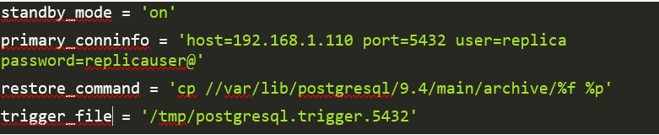
6-Recovery.conf file on standby
Datafile Directory→/var/lib/postgresql/11/main
Notes:
which tells PostgreSQL how to retrieve archived WAL file segments

Slide 31

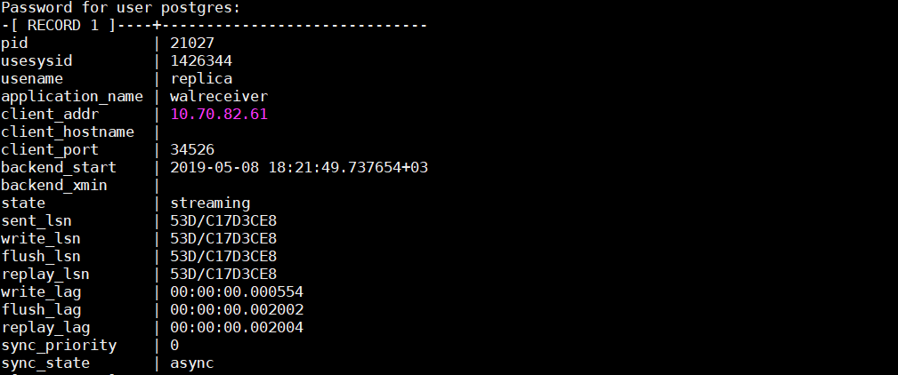
Test Replication
Streaming Replication is DONE
Command→psql -x -c "select * from pg_stat_replication;"

Slide 32

Cascading Postgresql Replication
Downstream Slaves
Upstream Slaves
async
1.
Slave
2.
hot_standby=on
3.
Syncronization
Replication
Slave
4.
recovery.conf
Cascading
Replicaiton
Slave
Master
Slave
Slave
Slave
Notes:
The cascading replication feature allows a standby server to accept replication connections and stream WAL records to other standbys, acting as a relay. This can be used to reduce the number of direct connections to the master and also to minimize inter-site bandwidth overheads.
A standby acting as both a receiver and a sender is known as a cascading standby. Standbys that are more directly connected to the master are known as upstream servers, while those standby servers further away are downstream servers. Cascading replication does not place limits on the number or arrangement of downstream servers, though each standby connects to only one upstream server which eventually links to a single master/primary server.

Slide 33
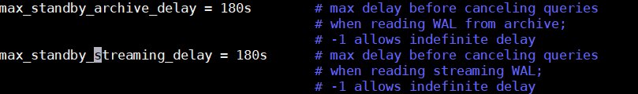
max_standby_archive_delay for standby
Notes:
When Hot Standby is active, this parameter determines how long the standby server should wait before canceling standby queries that conflict with about-to-be-applied WAL entries, as described in Section 26.5.2. max_standby_archive_delay applies when WAL data is being read from WAL archive (and is therefore not current). The default is 30 seconds. Units are milliseconds if not specified. A value of -1 allows the standby to wait forever for conflicting queries to complete. This parameter can only be set in the postgresql.conf file or on the server command line.

Slide 34
Logical Replication

Slide 35


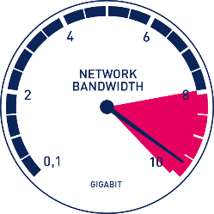
Logical replication
What is Logical Replication?
DB A
Employee
DB A
DB B
Master
Slave
Streaming replication
DB A
DB A
DB B
DB B
Master
Slave
Notes:
Why we need to Logical replication?
As we are moving out from physical replication, we are getting into Logical Replication

Slide 36


What is Logical Replication?
Logical replication
Select
Create index
Create table
Drop table
Create function
Insert
Master
Slave
Delete
Streaming replication
New Instance
Hot Standby
Select
Create index
Create table
Drop table
Warm Standby
Select
Create function
Insert
Master
Slave
Delete
Recovery Mode

Slide 37


What is Logical Replication?
Logical replication
PostgreSQL 11
PostgreSQL 12
PostgreSQL 10
PostgreSQL 11
Master
Slave
Streaming replication
PostgreSQL 9.5
PostgreSQL 9.5
PostgreSQL 10
Master
Slave

Slide 38



Expected use cases of Logical replication
2. Sharing a subnet of database
1. Analytical Purpose
Master A
DB C
Streaming replication
Master B
Client
1. High availability
2. Load Balancing
Master
Standby

Slide 39
Expected use cases of Logical replication
3. Online Upgrade
App
PostgreSQL 10
PostgreSQL 11
Logical Replication
Dump
Schema
Master A
Master B
Streaming replication
Client
1. High availability
2. Load Balancing
Master
Standby

Slide 40
Logical replication
Architecture
Publication
Subscription
WAL sender
Apply Worker
Master
Decoded message
Slave
Logical Replication Launcher
Decoding
triggers
Streaming replication
WAL
WAL Streaming
WAL sender
WAL receiver
Master
Slave
WAL
Notes:
Why we need to Logical replication?
As we are moving out from physical replication, we are getting into Logical Replication

Slide 41


What is Publication & Subscription?
Logical replication
Users
Name
Async vs Sync
Pub 3
Subs 3
Logical Replication Slot 1
Subscription 1
Publication 1
Slave A
Slave C
Publication 2
Users
Name
Surname
Subscription 2
Master
Logical Replication Slot 2
Streaming replication
Slave B
Streaming Replication
Slave
Cascading Replication
Slave
Master
Notes:
1- Each publication exists in only one database.
2- Publications may currently only contain tables.
3- Objects must be added explicitly, except when a publication is created for ALL TABLES.
Every publication can have multiple subscribers.
In the context of logical replication, a slot represents a stream of changes that can be replayed to a client in the order they were made on the origin server. Each slot streams a sequence of changes from a single database.
A logical replication slot knows nothing about the state of the receiver(s). It's even possible to have multiple different receivers using the same slot at different times; they'll just get the changes following on from when the last receiver stopped consuming them. Only one receiver may consume changes from a slot at any given time.

Slide 42

Logical replication
Surname
Address
Pub 1
Sub 1
Sub 2
Pub 2
DB A
DB B
Streaming replication
Slave
Slave
Master
Streaming Replication
Cascading Replication
Notes:
1- Each publication exists in only one database.
2- Publications may currently only contain tables.
3- Objects must be added explicitly, except when a publication is created for ALL TABLES.

Slide 43
Logical replication
Surname
Surname
Bi directional replication not allowed
Server A
Server B
Streaming replication
Slave
Slave
Master
Streaming Replication
Cascading Replication
Notes:
1- Each publication exists in only one database.
2- Publications may currently only contain tables.
3- Objects must be added explicitly, except when a publication is created for ALL TABLES.

Slide 44
Logical Replication Limitations in 11.0
does not replicate schema and DDL
does not replicate sequences
does not replicate Large Objects
Replication is only possible from base tables to base tables
Notes:
Sequence data is not replicated. The data in serial or identity columns backed by sequences will of course be replicated as part of the table, but the sequence itself would still show the start value on the subscriber.
If the subscriber is used as a read-only database, then this should typically not be a problem. If, however, some kind of switchover or failover to the subscriber database is intended, then the sequences would need to be updated to the latest values, either by copying the current data from the publisher (perhaps using pg_dump) or by determining a sufficiently high value from the tables themselves.
hat is, the tables on the publication and on the subscription side must be normal tables, not views, materialized views, partition root tables, or foreign tables

Slide 45


Logical replication with PostgreSQL 11
repluser
Publication 1
Subscribe1
user
user
WAL
Master
10.90.82.30
Slave
10.90.82.31
Pg_hba.conf→ host all repluser 10.90.82.31/0 md5
1.
wal_level = logical
1.
Connected to db with postgres →\c database2
2.
Connected to db with postgres →\c database1
2.
CREATE TABLE user (user_name text PRIMARY KEY,
full_name text);
CREATE TABLE user (user_name text PRIMARY KEY, full_name text);
3.
3.
CREATE SUBSCRIPTION Subscribe1 CONNECTION
'host=10.90.82.31 dbname=database1 user=repluser
password=admin123' PUBLICATION Publication 1 ;
4.
CREATE PUBLICATION Publication1 for table user;
5.
CREATE ROLE repluser WITH LOGIN PASSWORD 'admin123' REPLICATION ;
6.
GRANT SELECT ON public.delivery TO repluser;
7.
GRANT USAGE ON SCHEMA public TO repluser;
Logical Replication is DONE
Notes:
In logical level, the same information is logged as with replica, plus information needed to allow extracting logical change sets from the WAL. Using a level of logical will increase the WAL volume, particularly if many tables are configured for REPLICA IDENTITY FULL and many UPDATE and DELETE statements are executed.
Publications can choose to limit the changes they produce to any combination of INSERT, UPDATE, DELETE, and TRUNCATE, similar to how triggers are fired by particular event types. By default, all operation types are replicated.
Columns of a table are also matched by name. A different order of columns in the target table is allowed, but the column types have to match.

Slide 46

Topology(Logical & Pyhsical Replication)
Client
App Server
App Server
Reporting Server
write
write
read
read
read
read
CPU & Memory
Logical Replication
Streaming Replication
Cascading Replication
Slave
Master
Slave
Slave
Analytical purposes

Slide 47

Monitoring on Terminal
Master
Slave(Logical)
Slave(Physical)
1- pg_stat_replication
2- pg_replication_slots
3- pg_publication_tables
1- pg_subscription
2- pg_stat_subscription
3- pg_subscription_rel
1- pg_stat_wal_receiver

Slide 48

https://kahoot.it/

Slide 49




www.hepsiexpress.com
With an innovative service approach,
We are shaping delivery and transportation system in Turkey
Notes:
Şirkket olarak vizyonumuz avrupa birliği projelerinde de yer almak.

Slide 50

Hepsiexpress & Horizon 2020
We are looking for partners!
2018 Applications
Focus Areas for New Projects
Logistics Research & Innovation
Route Optimisation
Natural Language Processing
Open Source Softwares
ISA: Innovative logistics Solutions and data framework for the on-demand economy
Notes:
ISA project will provide value for city stakeholders of the on-demand economy in four case study areas, Barcelona, Istanbul, Maribor and Vienna, by guiding them in the design, implementation, modelling, assessment and uptake of innovative logistics solutions addressing shared, connected and low emission pick-up and delivery services. It was our first H2020 project which was rejected in early stage. We are willing to be a part of H2020 projects. If you are looking for partners please contact with me.

Slide 51
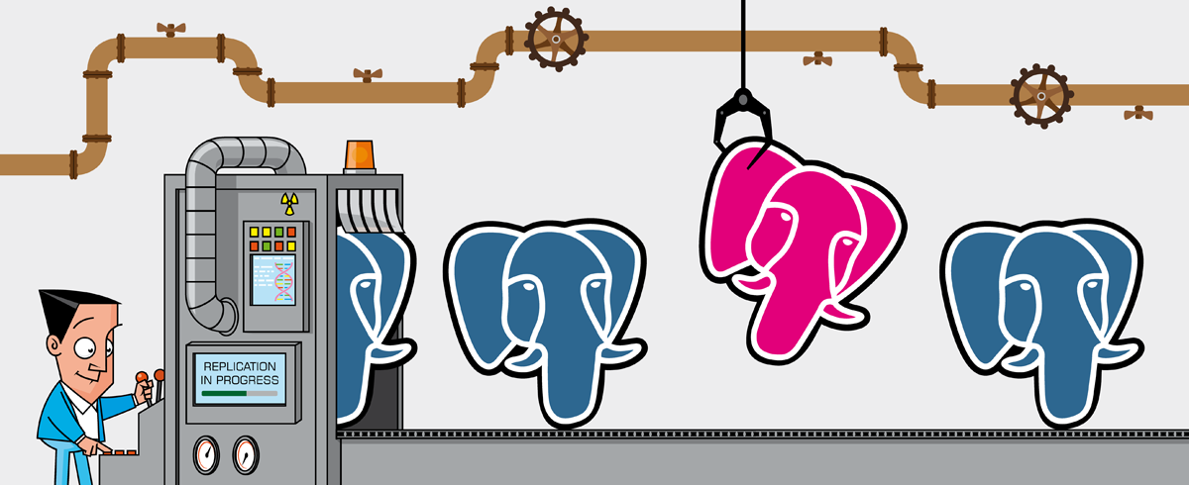
Thank you
Fırat Güleç

