Slide 1




Indexing Tips & Tricks

Slide 2
Fırat Güleç
- Company
GLCTECH
Now
Founder
PostgreSQL & NoSQL DB Consulting
Member of PostgreSQL Europe

Slide 3





What is index? Some Important Questions!!
#Tips 1
Do indexes always improve performance?
Is it correct to put an index on each table?
Is it correct to put an index on each column of table?
Do indexes slow down your database in some ways?
INSERT
UPDATE
Slowness
Bigger
Size

Slide 4
PostgreSQL Index types
#Tips 2
Query: create index users_username_ix on users (username);
B-tree(default)
Hash
GIST
SP-GIST
GIN
BRIN

Slide 5
Cardinality vs Selectivity
#Tips 3
Cardinality= select count(distinct (state_name)) from states;
Selectivity = (Distinct Values/Total number of records)

Slide 6

Auto indexed columns
#Tips 4
Primary keys
Unique keys

Slide 7

EXPLAIN EXPLAIN ANALYZE
#Tips 5

Slide 8

VACUUM ANALYZE
#Tips 6

Slide 9
CONCURRENTLY
#Tips 7
Query: CREATE INDEX CONCURRENTLY nasa_test_t_ix ON nasa_test(t);

Slide 10
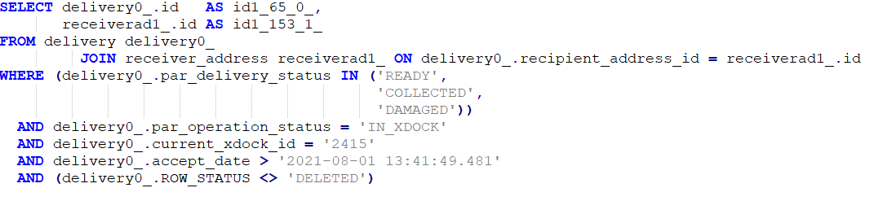
Explain Analyze
Total Exec Time:34 sn
Table 1: delivery--> 65 milyon rows
Index(btree) →par_delivery_status
Index(btree) →accept_date
Total Cost :8024
Each Index Size :410MB
Table 2: receiver_address--> 43 milyon rows
Index(btree) →id (primary key)
Each Index creation time :150 sec

Slide 11
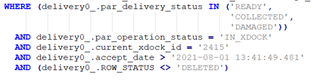
Multi Column & Partial Index & Order of Column
#Tips 8,9,10
more selective column come first
Not used!!!
Index Size: 2624 MB
Index Creation Time : 197.4 sec
%91 of column is DELIVERED
%90 of column is IN_RECIPIENT
%7 of column is DELETED
Conditions:
Index Size: 18 MB
It works
Index Creation Time : 150 sec

Slide 12
Index comparison
Not used!!!

Slide 13
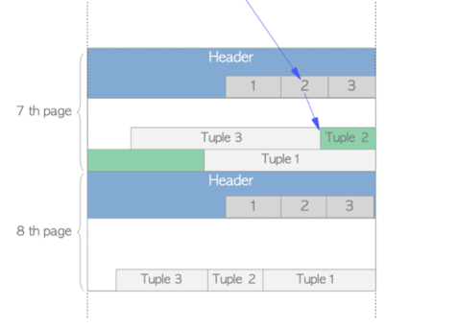
Index Scan(B tree)
random_page_cost=4
Query: create index index1 on users (a);
causes a lot of random I/O!!
Page
1
3
Index Tuples
Key=‘10’, TID=(Block=7,Offset=2)
Key=‘10’, TID=(Block=8,Offset=3)
Query: select * from users where a=10
Time Complexity =O(Log (n))
2
4

Slide 14
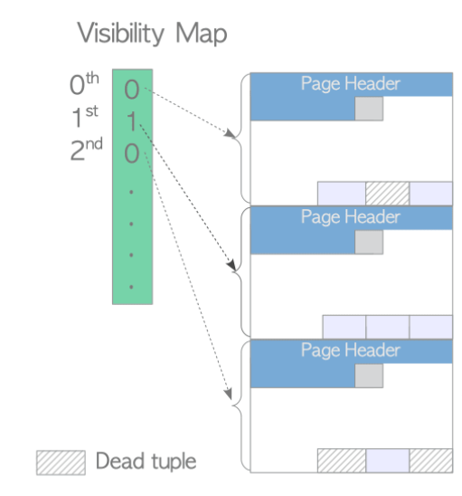
Index Only Scan
#Tips 11
Query: create index index1 on users (username,id);
Page
Index Tuple
Key=‘JERINA’-’34’, TID=(Block=0,Offset=2)
Key=‘JERINA’-’12’, TID=(Block=1,Offset=3)
Query: select username,id from users where username=‘JERINA’

Slide 15
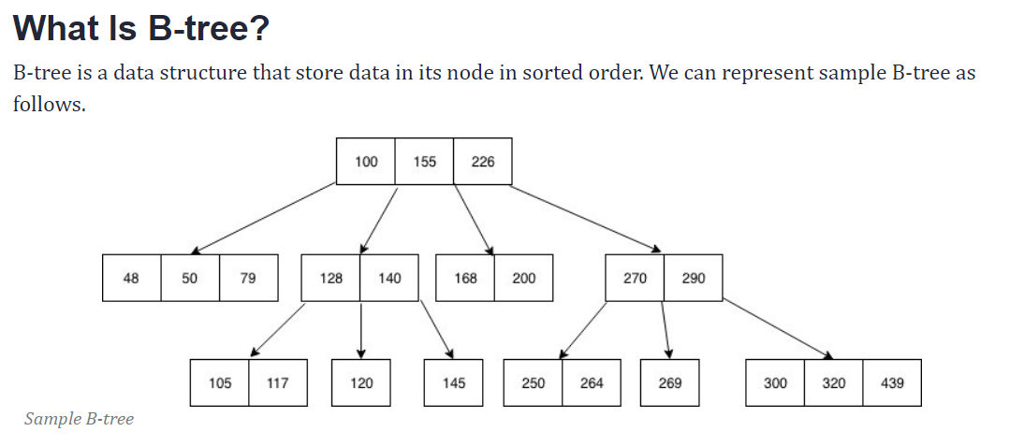
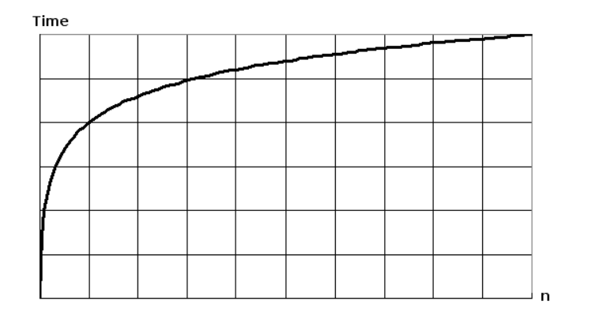
PostgreSQL Index types
B-tree(default) < <= = >= > Between IN
2. Hash =
  Hash index is usually smaller than a corresponding B-Tree index
  Hash index select and insert performance can be better than a B-Tree index
  Hash index has many restrictions that limit its use to very specific use cases
Time Complexity =O(Log (n))

Slide 16
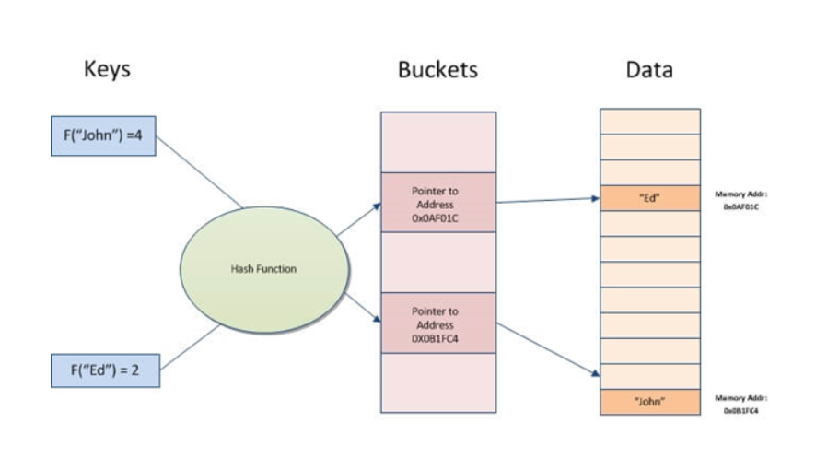
Hash Index

Slide 17
BRIN(Block Range Index)
Ordered big data sets
IOT devices
Dates
Large time-series data
Sensors, devices, tracking information, real-time bank transactions, and other things

Slide 18
GIN indexes
hStore
Arrays
Range types
JSONB
pg_trgm extention
LIKE
CREATE TABLE test_trgm (t text);
SELECT * FROM test_trgm WHERE t LIKE '%foo%bar';
CREATE INDEX trgm_idx ON test_trgm USING gin (t gin_trgm_ops);
EXPLAIN SELECT * FROM test_trgm WHERE t LIKE '%foo%bar';

Slide 19
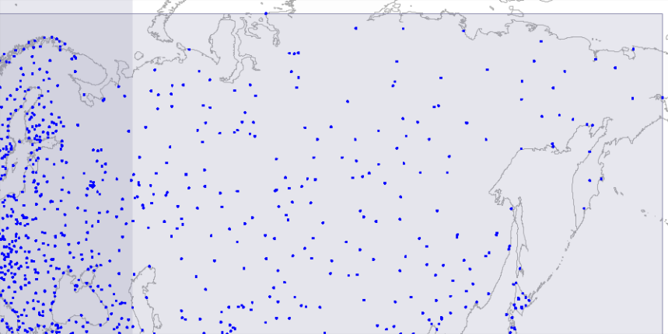
GIST
Geometry types
Text when dealing with full-text search
Search of nearest neighbors
SELECT * FROM places ORDER BY location <-> point '(101,456)' LIMIT 10;

Slide 20
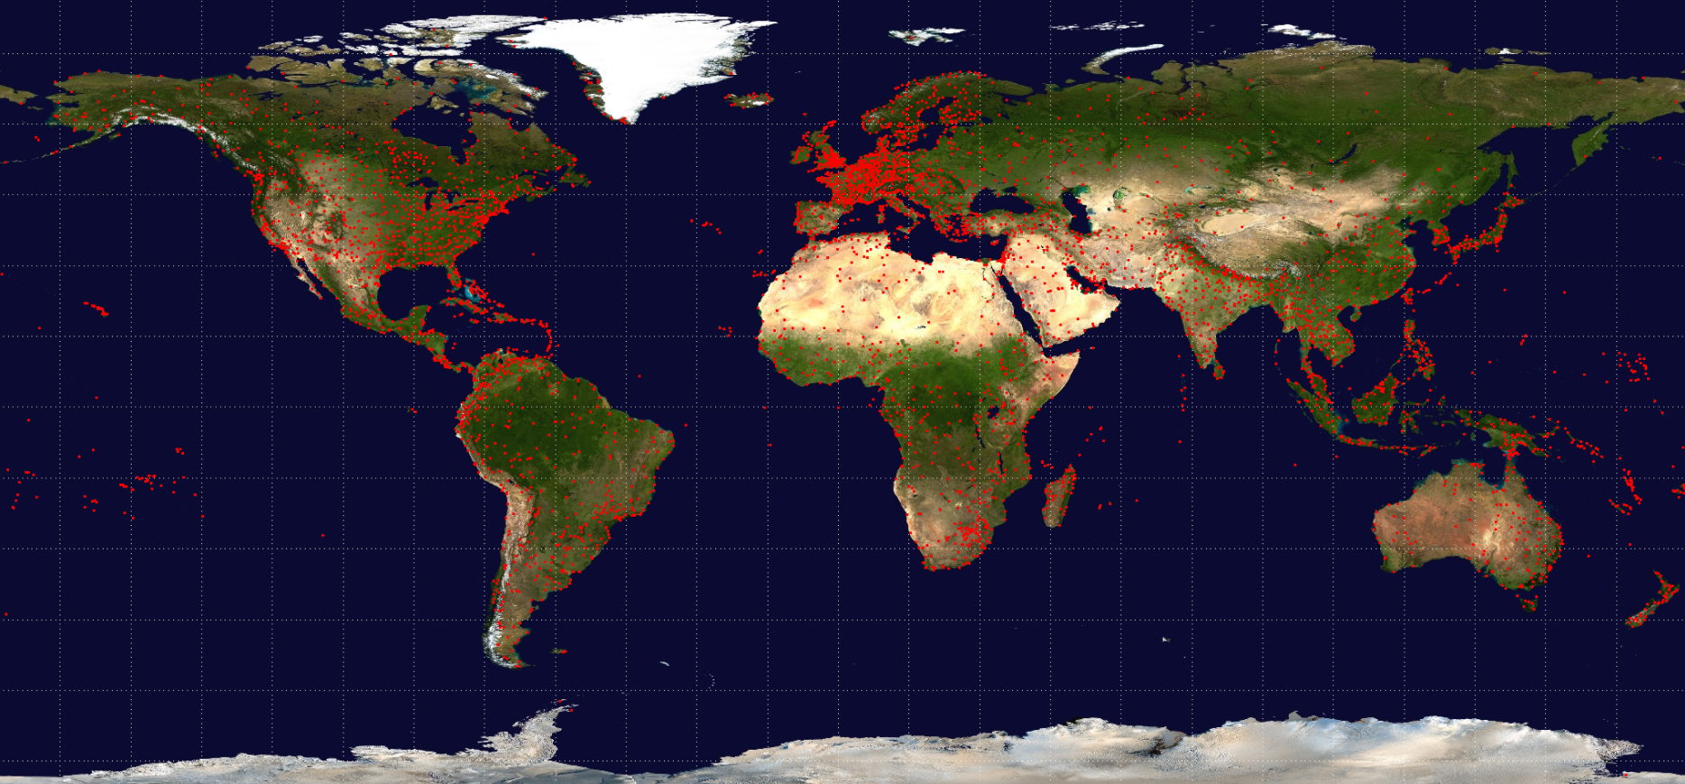
SP-GIST

Slide 21
Thank you so much for listening ☺

